Slide 1
Cloud Computing Fundamentals

Slide 2
cloud computing model types

Slide 3
Cloud computing models are generally categorized into
3 main service models
4 deployment models.

Slide 4
Cloud Service Models (What services are offered)
a. IaaS – Infrastructure as a Service
b. PaaS – Platform as a Service
c. SaaS – Software as a Service

Slide 5
A. IaaS – Infrastructure as a Service
Definition: Provides virtualized computing resources over the internet.
User manages: Operating systems, applications, runtime, and data.
Provider manages: Hardware, networking, storage, and virtualization.
Examples:
AWS EC2
Google Compute Engine
Microsoft Azure Virtual Machines
Use case: Hosting virtual machines, storage, networking, and testing environments.

Slide 6
B. PaaS – Platform as a Service
Definition: Provides a platform and environment to allow developers to build, test, and deploy applications.
User manages: Applications and data.
Provider manages: Infrastructure, runtime, OS, and middleware.
Examples:
Google App Engine
AWS Elastic Beanstalk
Microsoft Azure App Services
Use case: Web app development, APIs, and application hosting.

Slide 7
C. SaaS – Software as a Service
Definition: Delivers software applications over the internet on a subscription basis.
User manages: Only data and user access.
Provider manages: Everything (infrastructure, platform, and software).
Examples:
Google Workspace (Gmail, Docs)
Salesforce
Microsoft 365
Use case: Email, CRM, collaboration tools, office applications.

Slide 8
☁️ 2. Cloud Deployment Models (Where the cloud is deployed)
a. Public Cloud
Owned by: Third-party providers.
Shared resources over the internet.
Examples: AWS, Azure, Google Cloud.
Use case: Startups, general public access, scalability.
b. Private Cloud
Owned by: A single organization.
Dedicated infrastructure (on-premises or hosted).
Examples: VMware, OpenStack.
Use case: Enterprises needing high security or compliance.
c. Hybrid Cloud
Combination of: Public + Private clouds.
Enables: Data and application portability.
Use case: Businesses balancing flexibility and control.
d. Community Cloud
Shared by: Several organizations with similar requirements.
Managed by: One or more of the participating organizations or a third party.
Use case: Government or healthcare organizations.

Slide 9
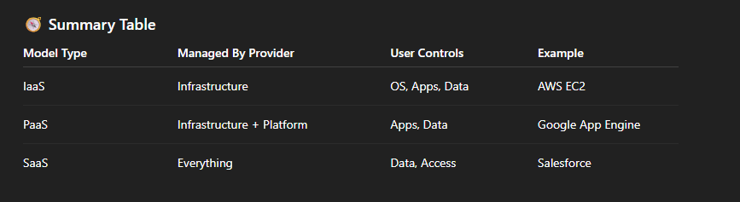

Slide 10
Challenges

Slide 11
1. Security & Privacy Issues
Data breaches & leaks: Sensitive data stored on third-party servers can be exposed.
Unauthorized access: Weak access controls or misconfigurations may lead to attacks.
Data privacy compliance: Hard to ensure compliance with laws like GDPR, HIPAA, etc.
Shared environment risks: Multi-tenant setups can create security vulnerabilities.
2. Downtime & Service Reliability
Internet dependency: Cloud services require constant internet connectivity.
Service outages: Even major providers (AWS, Azure, GCP) can face downtime.
Limited control: Users rely on the provider to restore services quickly.
3. Cost Management
Unpredictable costs: Pay-as-you-go models can become expensive without monitoring.
Hidden fees: Data transfer, API calls, or scaling costs can add up.
Overprovisioning: Poor resource management leads to wasted expenses.

Slide 12
4. Data Control & Governance
Data location uncertainty: Data may be stored in multiple countries or data centers.
Vendor lock-in: Difficult to migrate to another provider due to proprietary technologies.
Limited visibility: Users may not have full control over how data is managed.
5. Performance & Latency
Network delays: Data transfer between users and cloud servers may cause lag.
Resource contention: Shared infrastructure can affect performance during high demand.
Geographical distance: Servers far from users increase response time.
6. Compliance & Legal Concerns
Regulatory challenges: Meeting regional or industry-specific standards (e.g., banking, healthcare).
Data sovereignty: Legal restrictions on where data can be stored or processed.
Auditing difficulties: Hard to verify security practices of cloud providers.

Slide 13
7. Technical & Skill Gaps
Lack of expertise: Organizations may lack skilled professionals for cloud migration or management.
Complexity: Managing hybrid or multi-cloud environments can be technically challenging.
Integration issues: Connecting legacy systems with modern cloud platforms isn’t always smooth.
8. Migration Challenges
Data transfer difficulties: Moving large datasets is time-consuming and costly.
Application re-engineering: Some apps must be redesigned to run in the cloud.
Downtime during migration: Transition may temporarily disrupt operations.

Slide 14
Pricing

Slide 15
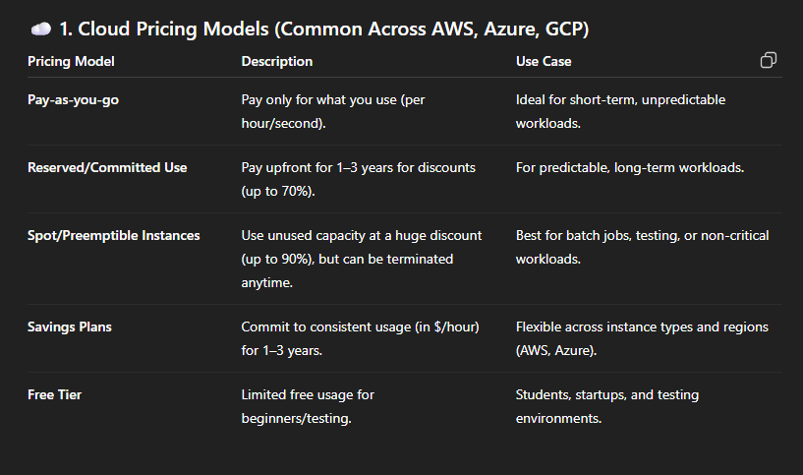

Slide 16
AWS Pricing Overview
Compute (EC2):
On-demand: ~$0.0116/hour (t4g.micro)
Reserved instances: Up to 75% cheaper
Spot instances: Up to 90% discount
Storage (S3):
$0.023/GB per month (Standard storage tier)
Cheaper tiers for infrequent or archival storage
Database (RDS):
Depends on instance type and storage size
Free tier: 750 hours/month for 12 months
Free Tier:
12 months free (EC2, S3, RDS, Lambda, etc.)
Always free: 1M Lambda requests/month

Slide 17
Microsoft Azure Pricing Overview
Compute (VMs):
B1s VM: ~$0.012/hour
Discounts up to 72% with Reserved Instances
Storage (Blob):
$0.0184/GB (Hot storage)
$0.01/GB (Cool)
$0.00099/GB (Archive)
Database (SQL DB):
Basic tier starts around $5/month
Free Tier:
$200 credit for first 30 days
12-month free limited services

Slide 18
Google Cloud (GCP) Pricing Overview
Compute (Compute Engine):
e2-micro instance: ~$0.0096/hour
Sustained use discounts: Up to 30% automatically
Preemptible VMs: Up to 80% cheaper
Storage (Cloud Storage):
$0.020/GB (Standard)
$0.010/GB (Nearline)
$0.004/GB (Coldline)
Database (Cloud SQL):
Small instance ~$0.017/hour
Free Tier:
Always free e2-micro VM (1 vCPU, 0.6 GB RAM)
$300 free credit for 90 days

Slide 19
AWS vs Azure vs GCP
Feature | AWS (Amazon Web Services) | Azure (Microsoft Azure) | GCP (Google Cloud Platform)
Launch Year | 2006 (oldest) | 2010 | 2011
Market Share | 🥇 Largest (~31–33%) | 🥈 Second (~23–25%) | 🥉 Third (~10–12%)
Compute | EC2, Lambda | Virtual Machines, Functions | Compute Engine, Cloud Functions
Containers | ECS, EKS | AKS | GKE (best-in-class)
Storage | S3, EBS, Glacier | Blob Storage, Disk Storage | Cloud Storage
Free Tier | Limited (12 months + always free) | Limited | Most generous free tier

Slide 20
AWS vs Azure vs GCP
Databases | RDS, DynamoDB, Aurora | Azure SQL, Cosmos DB | Cloud SQL, BigQuery, Spanner
Data Warehouse | Redshift | Synapse Analytics | BigQuery (leader)
ETL / Data Integration | Glue | Data Factory | Dataflow
Streaming | Kinesis | Event Hubs | Pub/Sub
AI / ML | SageMaker | Azure ML | Vertex AI (strong)
DevOps Tools | CodePipeline, CodeBuild | Azure DevOps | Cloud Build
Networking | VPC, Route 53 | Virtual Network, Traffic Manager | VPC, Cloud DNS
Security & IAM | IAM (complex but powerful) | Azure AD (best for enterprises) | Cloud IAM (simpler)
Hybrid Cloud | Outposts | Azure Arc (best) | Anthos
Pricing Model | Pay-as-you-go (complex) | Pay-as-you-go + enterprise discounts | Simpler & transparent

